Slide 1
Management of Big Mountain Resort

Slide 2
Problem identification
By how much can Big Mountain resort increase it’s ticket value without undermining the value of the ticket and cutting costs by the first season?

Slide 3
Recommendation and key findings
Key Findings
Guaranteed snow cover
Ratio of runs to chairs
Fast quads
Vertical drops
Recommendations
Cut cost without undermining the ticket
Supporting a higher ticket price

Slide 4
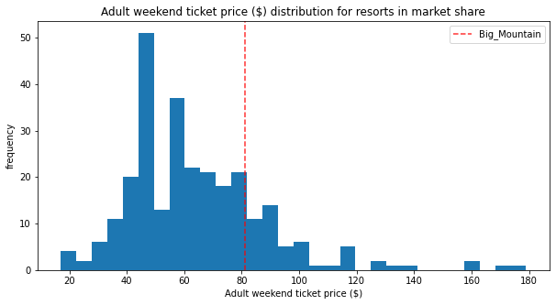
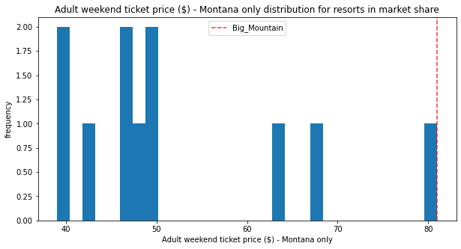
Modeling results and analysis
Graph 1. Where Big Mountain sits overall amongst all resorts for price.
Graph 2. Where Big Mountain sits overall amongst all resorts for price at resorts in Montana.

Slide 5
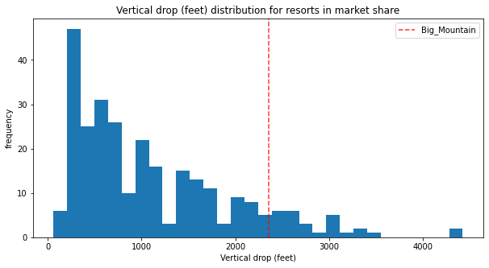
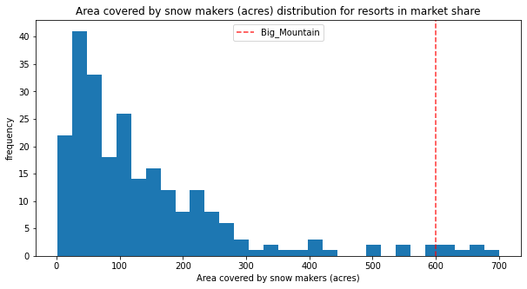
Modeling results and analysis
Graph 4. Big Mountain is doing well for vertical drop. Room for development.
Graph 4. Big Mountain is very high up the league table of snowmaking area.

Slide 6
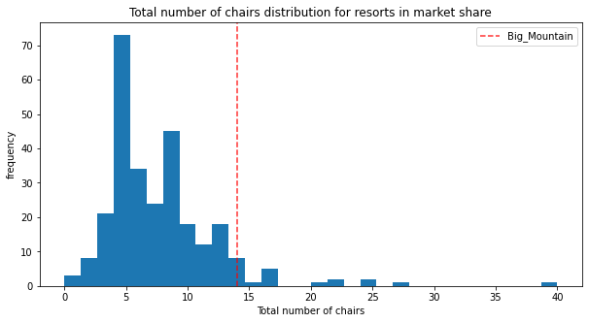
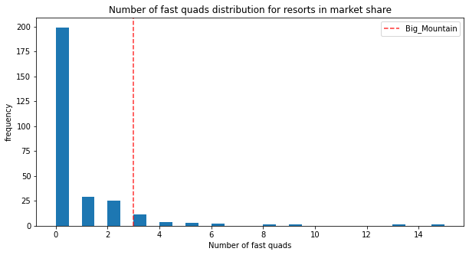
Modeling results and analysis
5. Big Mountain has amongst the highest number of total chairs.
Graph 6. Most resorts have no fast quads. Big Mountain has 3, which puts it high up that league table.

Slide 7
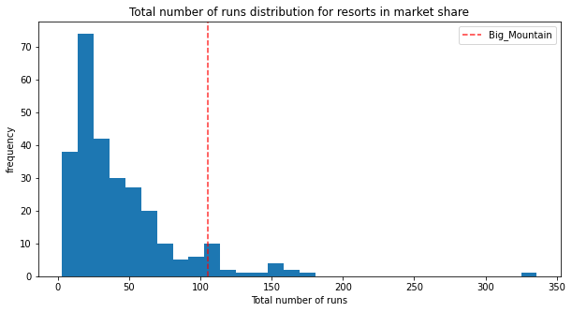
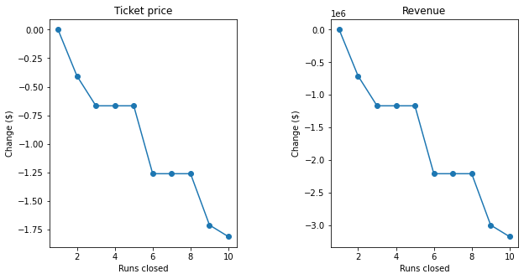
Modeling results and analysis
Graph 7. Big Mountain compares well for the number of runs. There are some resorts with more, but not many.
Graph 8. Closing 2 and 3 successively reduces support for ticket price and so revenue. If Big Mountain closes down 3 runs, it seems they may as well close down 4 or 5 as there's no further loss in ticket price.

Slide 8
Summary and conclusion
Currently Big Mountain Resort ticket price is 81.00 but can increase by $1.99 to $10.39. Big Mountain has many facilities in which they excel. Big Mountain is doing well for vertical drop, snow making area,highest number of total chairs, fast quads,largest amount of skiable terrain,and one of the longest runs.
I would suggest to close down up to 4 runs and to increase the vertical drop by 150 feet and installing a new chair lift. It increases the ticket price by 1.99 with an expected about of $3474638 over a season. Operating the new chair could be covered by the cost of the increase of the ticket price which would value to $3474638 in the first season alone if a visitor on average buys 5 day tickets. I recommend to to temporarily close down the 2-3 less used runs for the first season and then permanently close them if you are satisfied in the first season and the following season to increase it to a total of 4-5 runs. Closing down these runs will not drop the ticket price and increase the value of the ticket while saving money.

